Slide 1
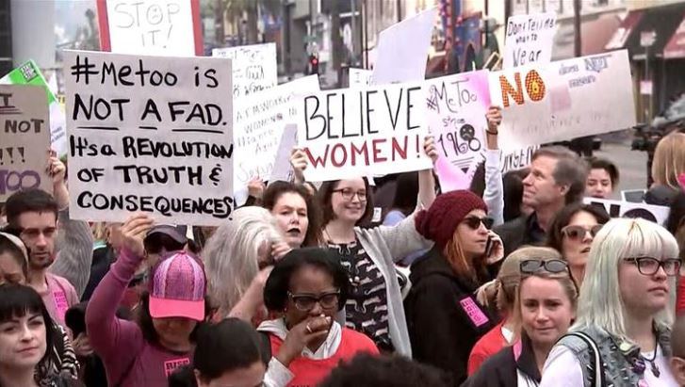
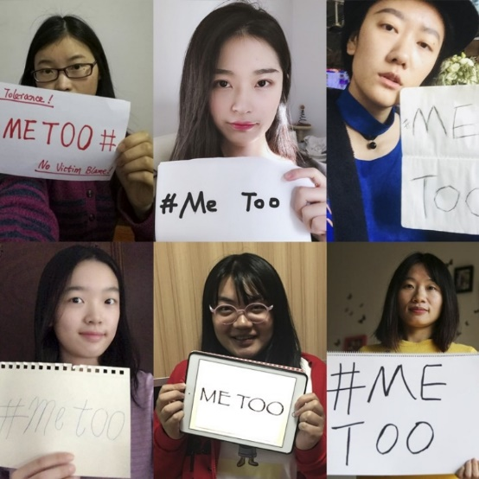
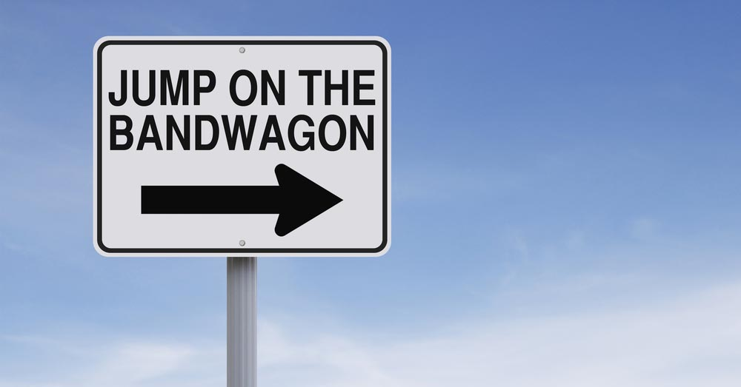
Conversation class
Jumping on the bandwagon
Momentum
Power
Privilege
Position
Status
Rights
Consequences
(is there a new message?)
Protest
Influence
Reluctance
Christopher bAUMAN

Slide 2
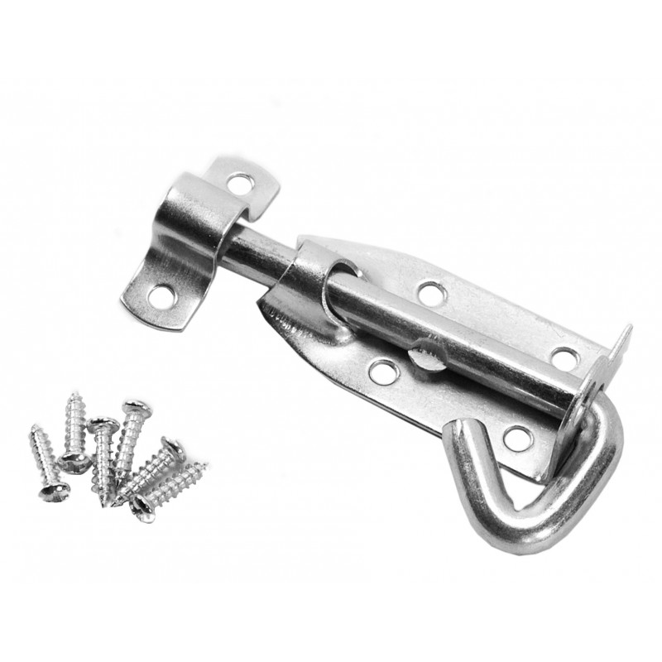
Education Infographic
https://www.commonfloor.com/guide/10-safety-tips-for-single-women-at-apartment-complex-29597.html
10 tips on keeping safe…
How can you keep safe?
Alone
When out
Online
Rebuilding
-Self confidence
-Trust
-Dignity
-Time
-Assistance
Teachers
Education
Skills
Chris Bauman

